Slide 1
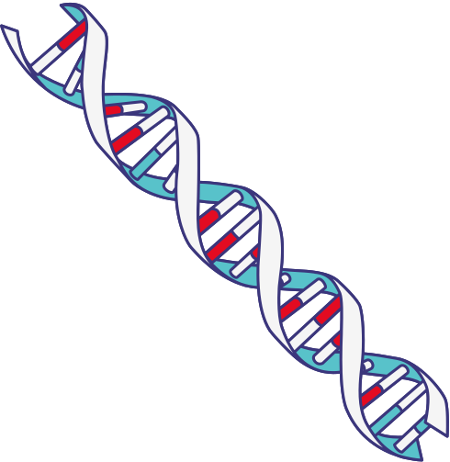
INTRO TO BIOINFORMATICS
X:@angeomics

Slide 2
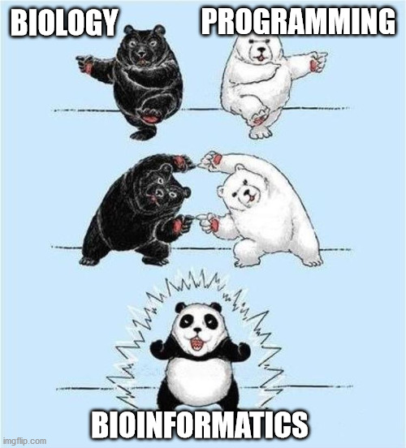
What is Bioinformatics?

Slide 3
What is Bioinformatics?
Bioinformatics is a field that combines biology, computer science, and mathematics to analyze and interpret biological data, especially large datasets generated by modern techniques like genome sequencing.

Slide 4
What is Bioinformatics?
It involves the development of tools and methods for understanding biological information, such as DNA sequences, protein structures, and gene expressions.

Slide 5
What is Bioinformatics?
Key areas within bioinformatics include genome assembly, sequence alignment, gene prediction, protein structure analysis, and data integration from various biological sources.

Slide 6
What is Bioinformatics?
This field has become essential in genomics, medicine, agriculture, and environmental sciences.

Slide 7
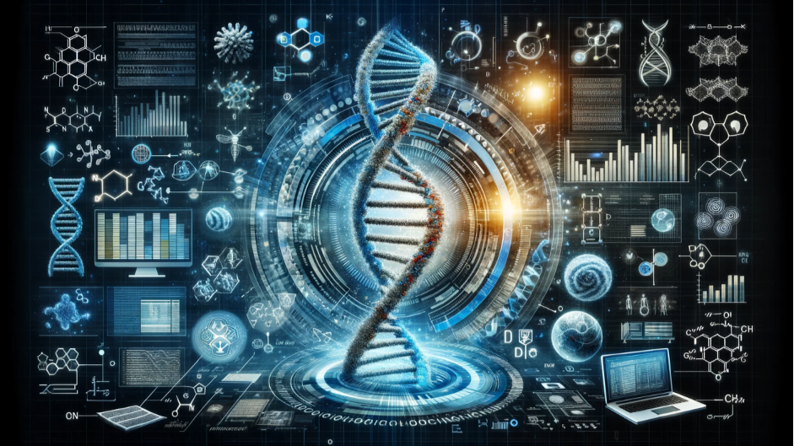
IMPORTANCE OF BIOINFORMATICS

Slide 8
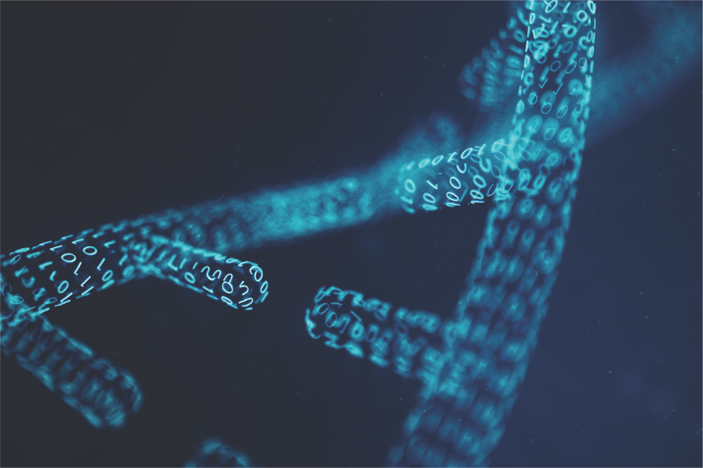
Bioinformaticians: the Hidden Heroes
of the COVID-19 Pandemic
“To leverage big data, from the first publicly available SARS-CoV-2 genome sequence and computational models to understand the virus and predict mutations, through to screens for potential therapies and vaccines – bioinformaticians have had a crucial role to play every step of the way.
“
Torrington (2022)

Slide 9

Human genome fully assembled!

Slide 10
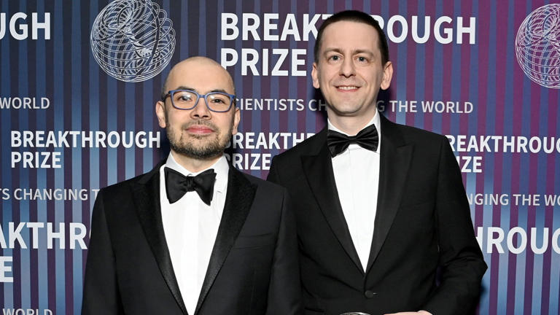
DeepMind’s Demis Hassabis and John Jumper scoop Nobel Prize in Chemistry for AlphaFold
DeepMind CEO Demis Hassabis and Director John Jumper

Slide 11
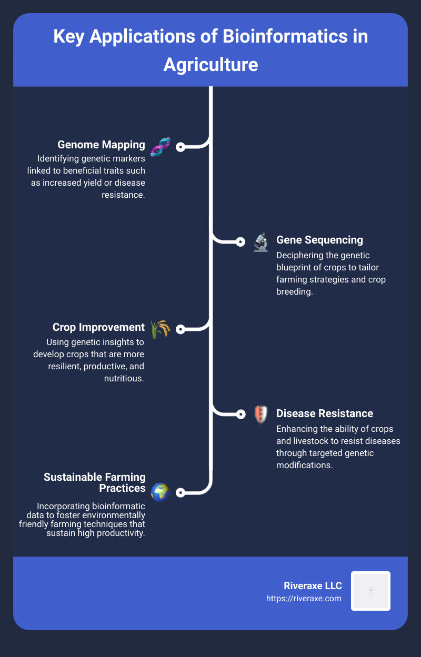
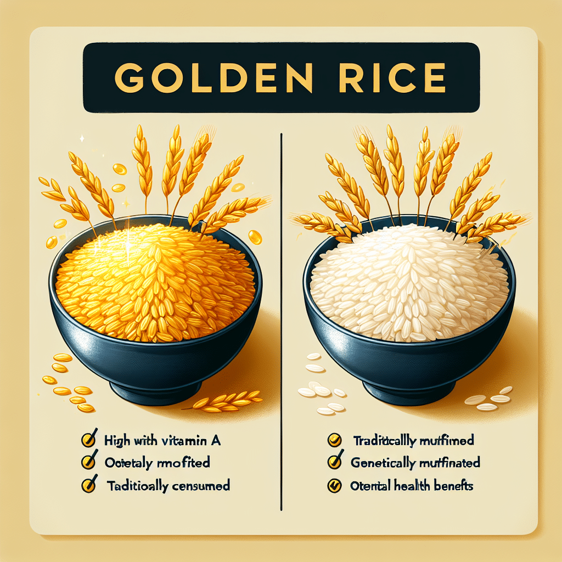

Sanatech Seed's Sicilian Rouge
High gamma-aminobutyric acid GABA tomato

Slide 12
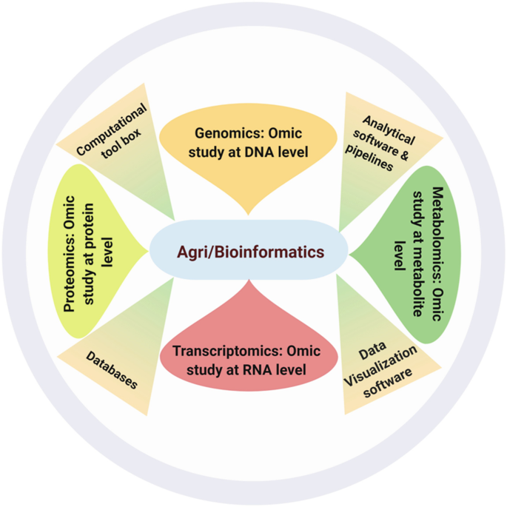
Agri/Bioinformatics: Shaping Next-Generation Agriculture | SpringerLink

Slide 13

Global Bioinformatics Service Market size was valued at USD 2.45 billion in 2023 and is projected to reach USD 6.41 billion by 2031, growing at a CAGR of 16.65% from 2022 to 2031 according to a new report by IMIR Market Research.

Slide 14

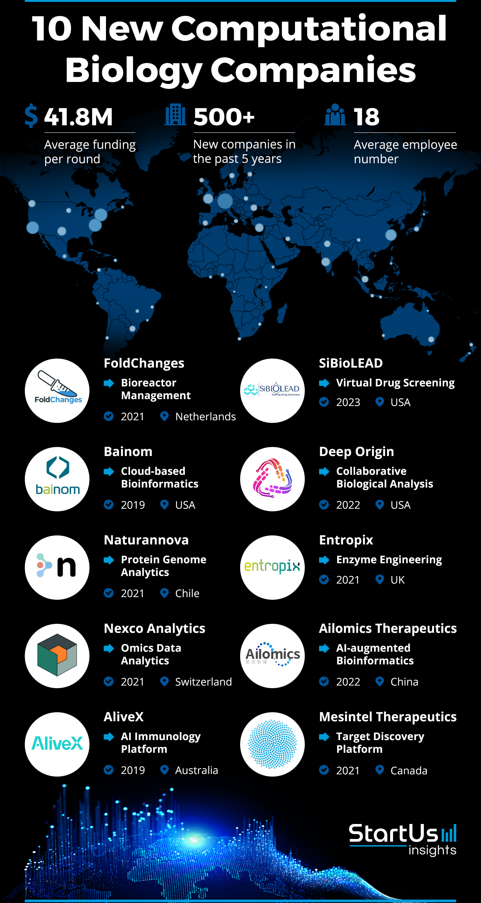

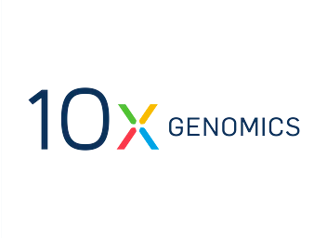



and many more…
10 New Computational Biology Companies | StartUs Insights

Slide 15
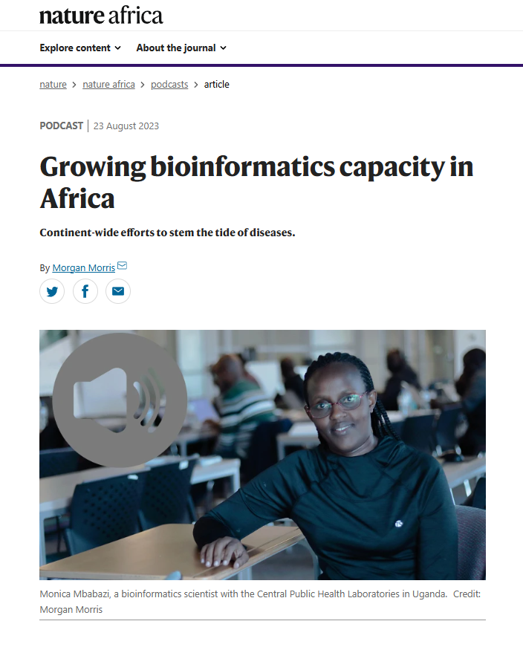



Co-founder
Yedomon Ange Bovys Zoclanclounon
CEO and Co-founder
Julien Alban Nguinkal
Coming soon …

Slide 16

Key Areas of Bioinformatics
Genomics
1
Genome Sequencing
2
Genome Assembly
Genome sequencing determines the complete DNA sequence of an organism, providing a blueprint for its genetic makeup.
Genome assembly puts together the fragmented DNA sequences obtained during sequencing, reconstructing the complete genome.
3
Genome Annotation
Genome annotation identifies and labels the different genes, regulatory elements, and other functional components within a genome.

Slide 17
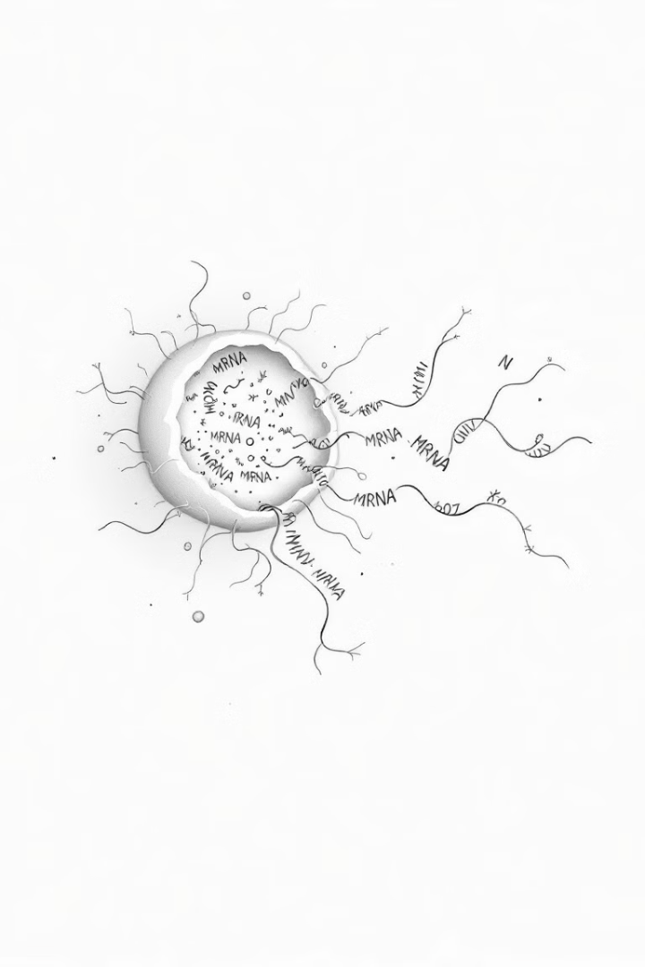
Transcriptomics
1
Gene Expression Analysis
This involves measuring the abundance of RNA transcripts, which provides insights into gene activity and cellular processes.
2
Transcript Identification
Transcriptomics also aims to identify and characterize different RNA transcripts, including protein-coding and non-coding RNAs.
3
Regulation of Gene Expression
Studying gene expression patterns helps researchers understand how gene expression is regulated, contributing to disease development and response to environmental cues.

Slide 18
Proteomics
Protein Structure
Protein Function
Protein structure analysis focuses on determining the three-dimensional shape of proteins, which is crucial for their function.
Understanding protein function involves studying how proteins interact with other molecules, perform specific tasks, and contribute to biological processes.
Metabolomics… Lipidomics… Epigenomics… Metagenomics …etc…

Slide 19

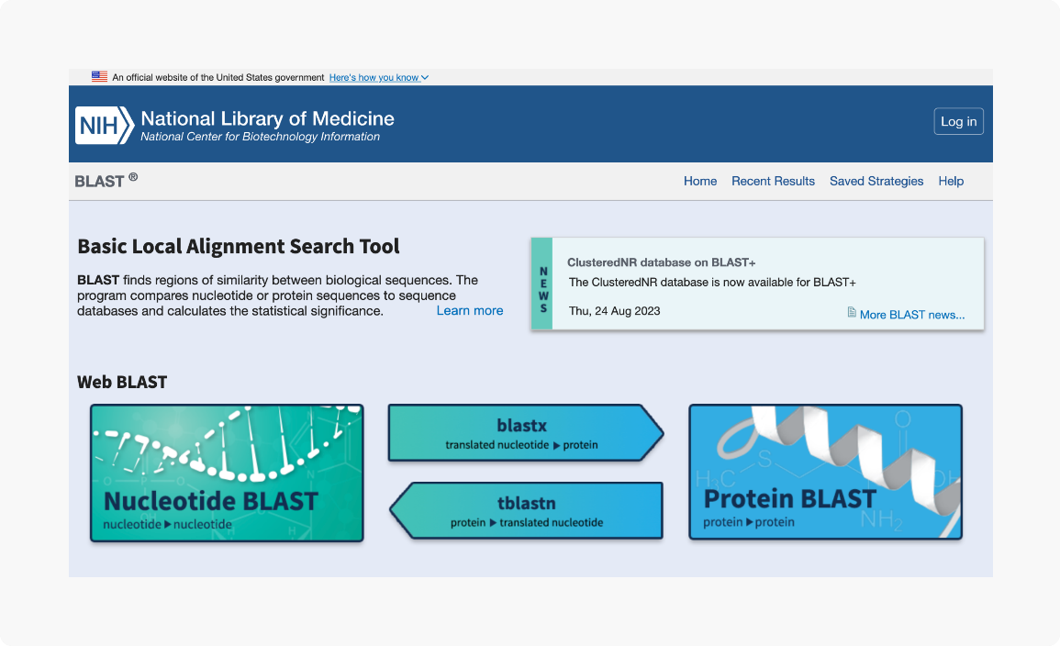
Computational Algorithms and Software Development
Algorithms
Software Development
Open-Source Tools
Developing new algorithms and software tools to address specific challenges in bioinformatics, such as sequence alignment, gene prediction, and protein structure prediction.
Creating user-friendly software platforms for data analysis, visualization, and interpretation, making bioinformatics tools accessible to researchers.
Many bioinformatics tools are open-source, fostering collaboration and accessibility within the scientific community.

Slide 20
Challenge and Future Directions of Bioinformatics
Advances in Artificial Intelligence
and Machine Learning
AI-driven Bioinformatics
Handling Big Data and
Computational Requirements
CPU to GPU
Data Integration from
Various Sources
Multi-Omics

Slide 21
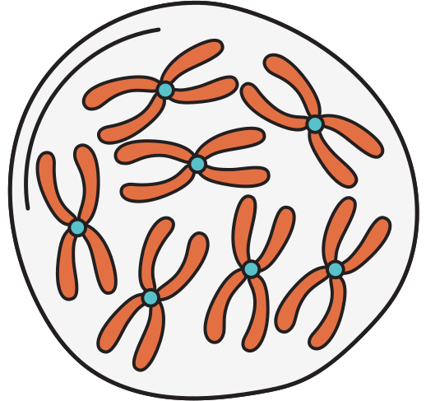
Thank you

